Slide 1
2022-2023 Title I Superheroes: Transforming Minds, One Superpower at a Time
CEP Designation

Slide 2
Title I, Migrant and Special Programs Luwando Wright, Director
Community Eligibility Provision (CEP)
CEP and Title I Eligibility
Title I Eligibility Dashboard

Slide 3
Community Eligibility Provision (CEP)
Schools participating in the National School Lunch and school Breakfast Programs with 40% or more students receiving SNAP, TANF or Extension of Benefits.
All students enrolled are eligible to receive Breakfast and Lunch at no cost.
No action by the parent or child.

Slide 4
CEP and Title I Eligibility
Title I uses the percentage of students on free and reduced lunch to determine eligibility. The district uses two ways to determine whether a student is on free or reduced lunch:
For Non – CEP schools, lunch applications completed by families are collected at the start of the school year, and this dictates the number of children on free or reduced lunch.
For CEP schools, the percentage of students on free or reduced lunch is calculated based on the number of students directly certified (e.g. through SNAP, TANF, homeless, Head Start, migrant, among other categories). The percentage of directly certified students is then multiplied by the 1.6 multiplier – this final percentage is utilized to determine Title I eligibility

Slide 5
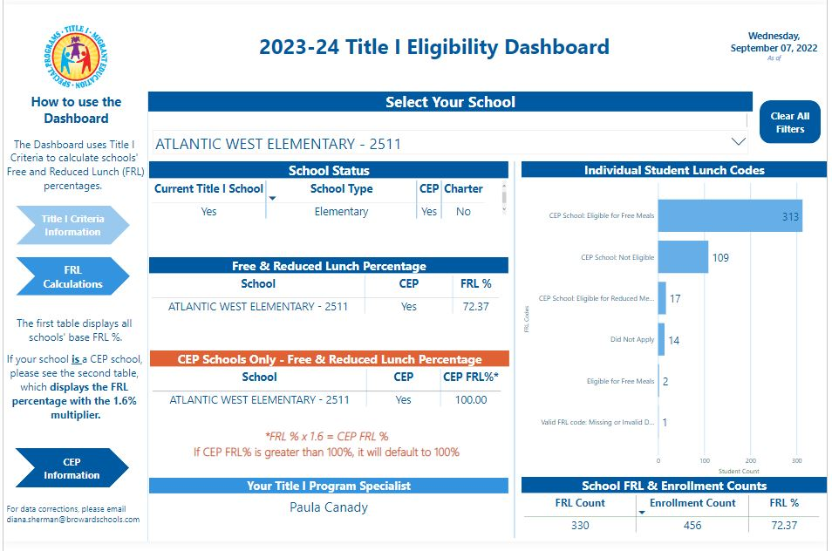

Slide 6
Title I Superheroes: Transforming Minds, One Superpower
at a Time
Thank you so much

Slide 7
2022-2023 Title I Superheroes: Transforming Minds, One Superpower at a Time

